Slide 1
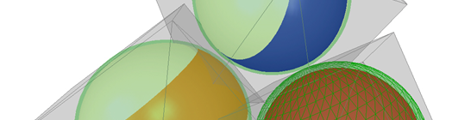
Collision Detection Algorithms
Clemens Kmentt

Slide 2
Warum brauchen wir Collision Detection?

Slide 3
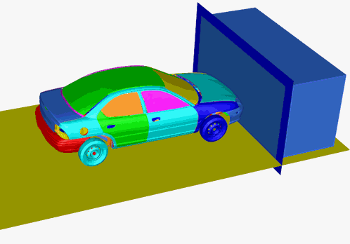

Slide 4
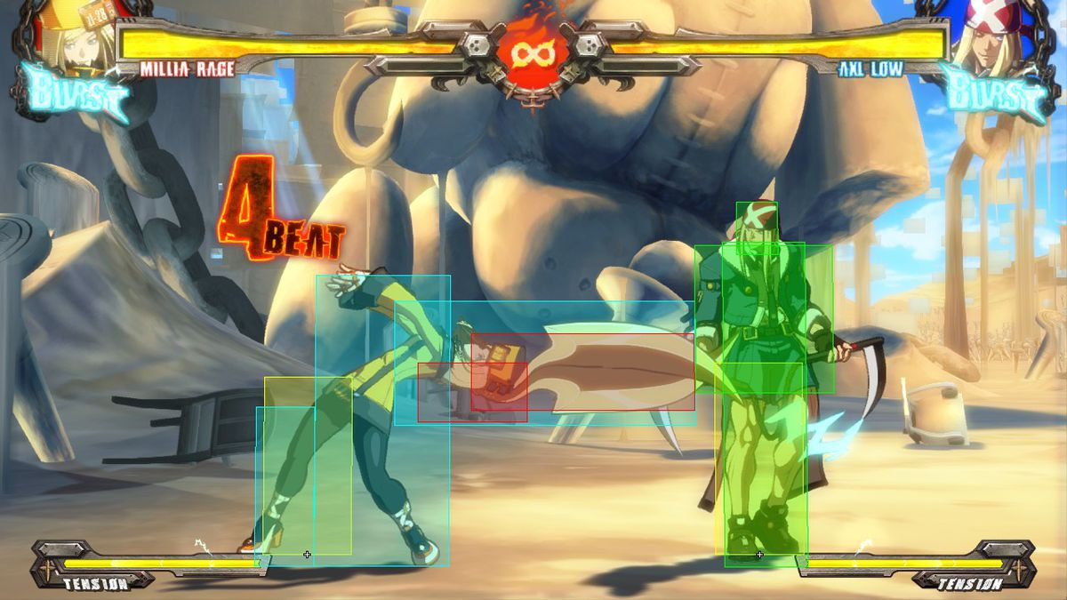

Slide 5
Wie entdeckt man Kollisionen?

Slide 6
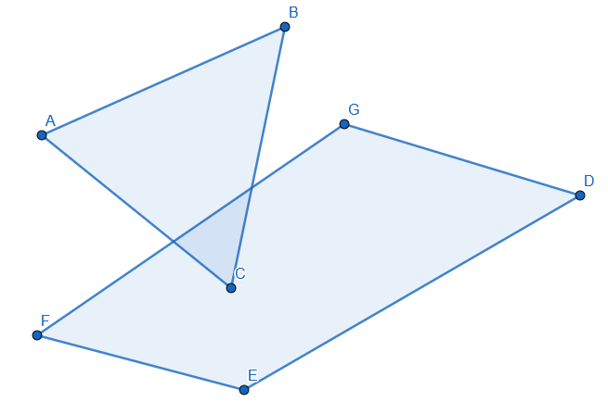

Slide 7
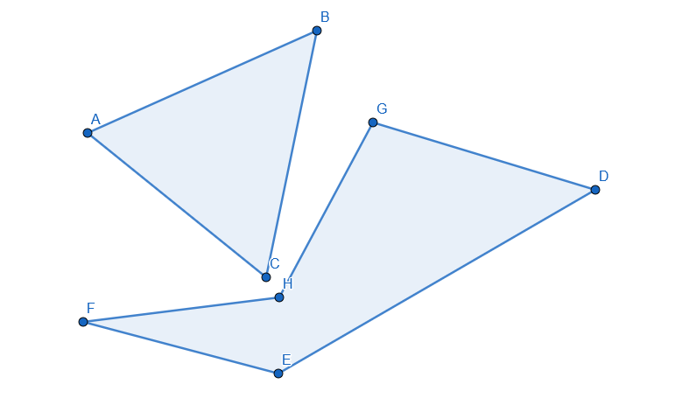

Slide 8
Broad-Phase Collision Detection
AABB (Axis-Aligned Bounding Boxes)
SAT (Separated Axis Theorem)

Slide 9
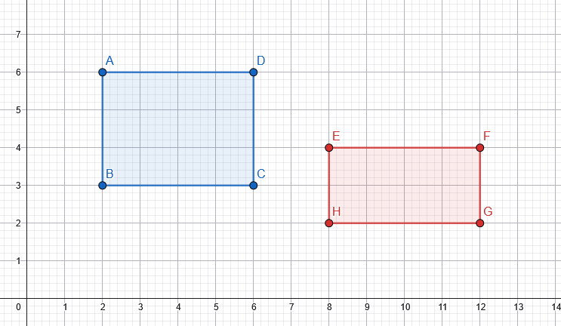
Axis-Aligned Bounding Boxes

Slide 10
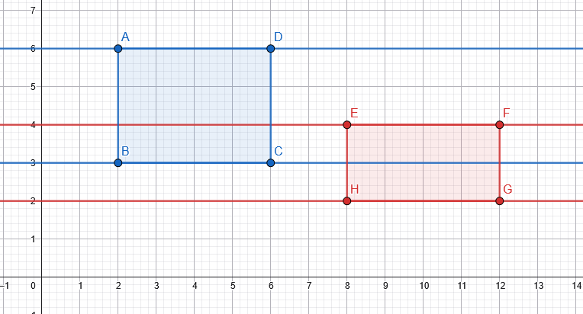
Axis-Aligned Bounding Boxes

Slide 11
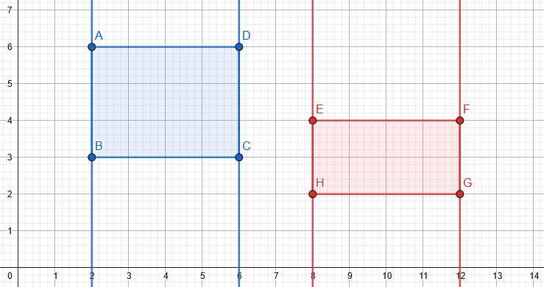
Axis-Aligned Bounding Boxes

Slide 12
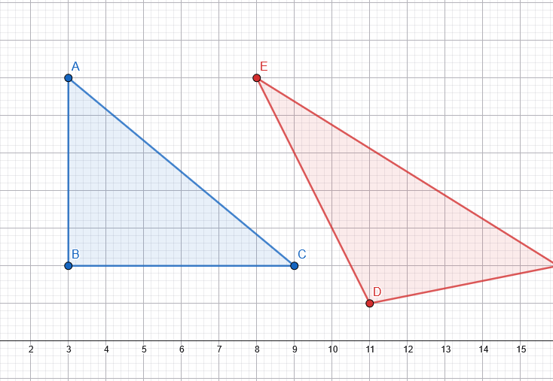

Slide 13
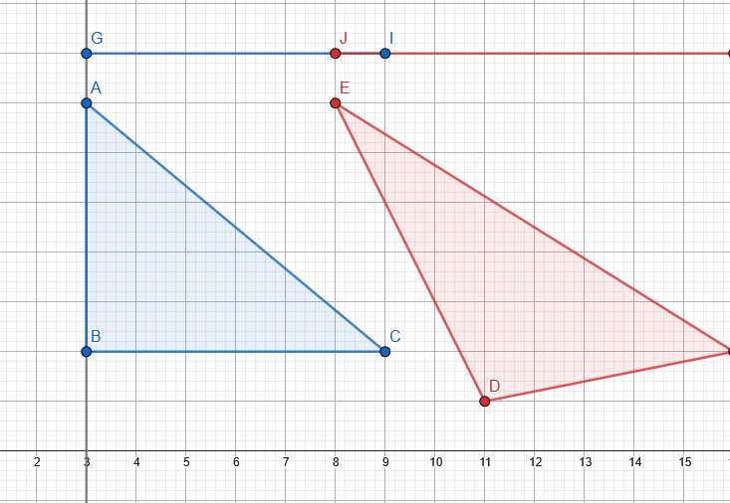
Separated Axis Theorem

Slide 14
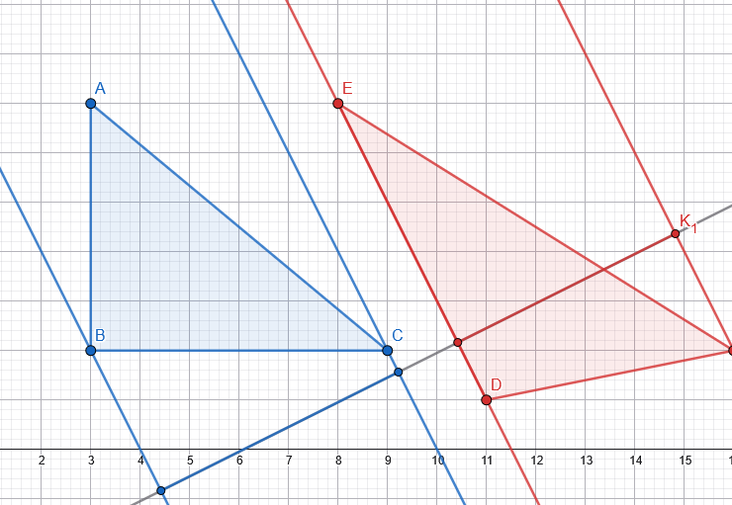
Separated Axis Theorem

Slide 15
Narrow-Phase Collision Detection
GJK
EPA

Slide 16
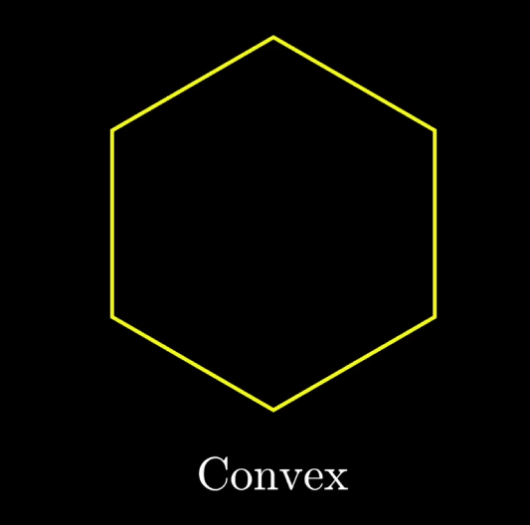

Konvex vs Konkav

Slide 17
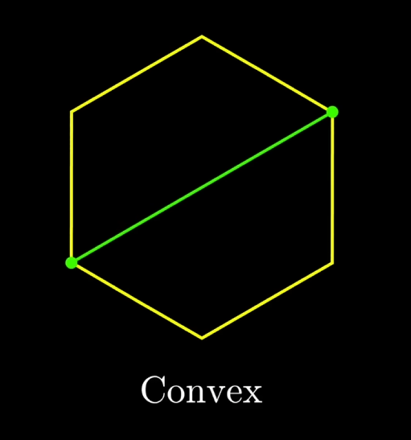
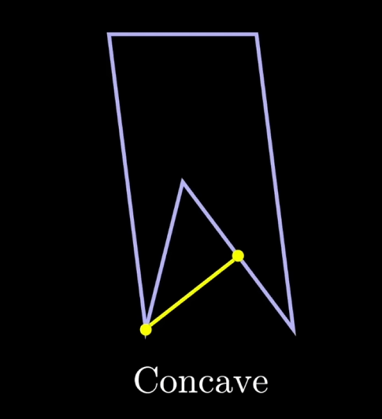
Konvex vs Konkav

Slide 18
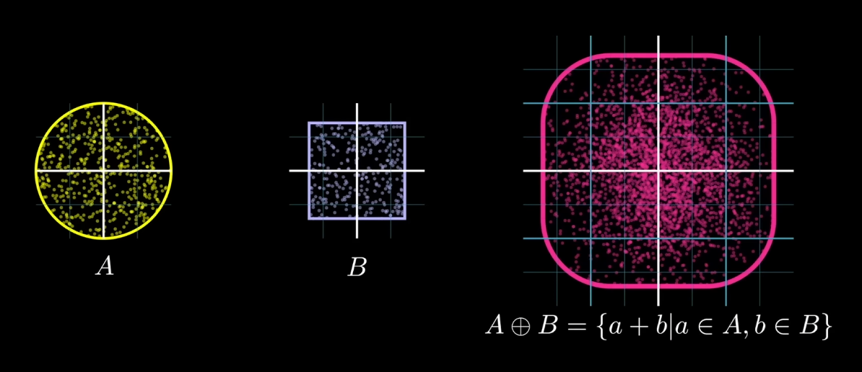
Minkowski-Summe

Slide 19
Minkowski-Summe

Slide 20
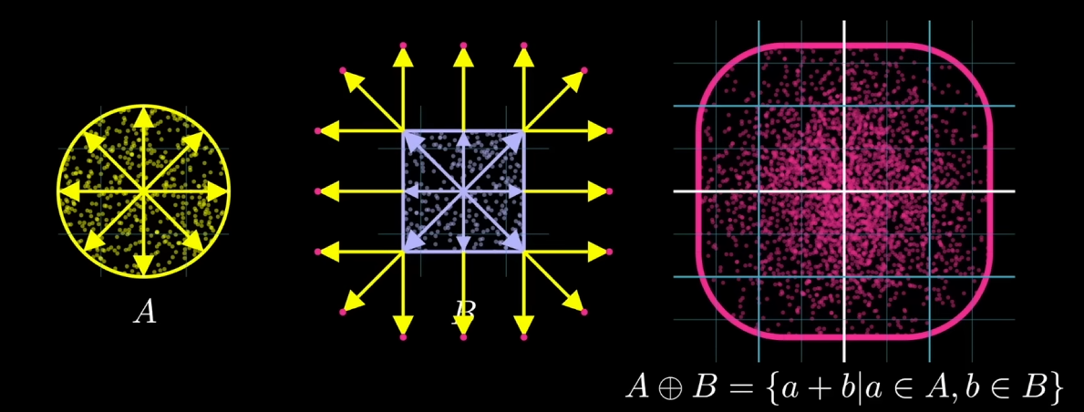
Minkowski-Summe

Slide 21
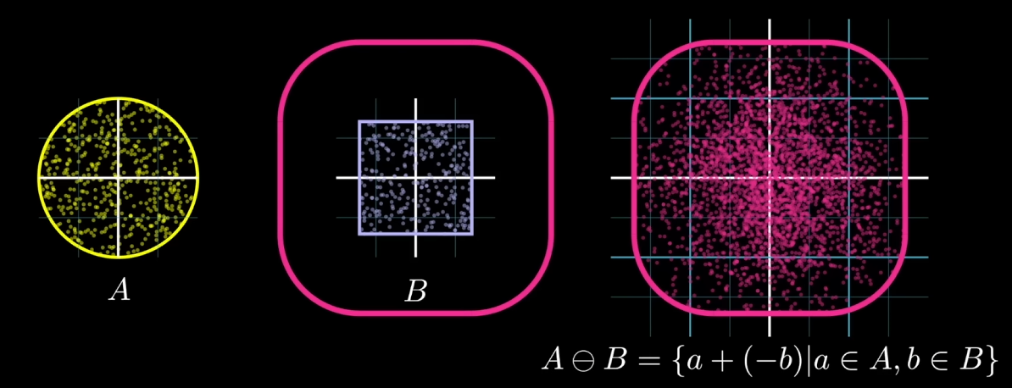
Minkowski-Differenz

Slide 22
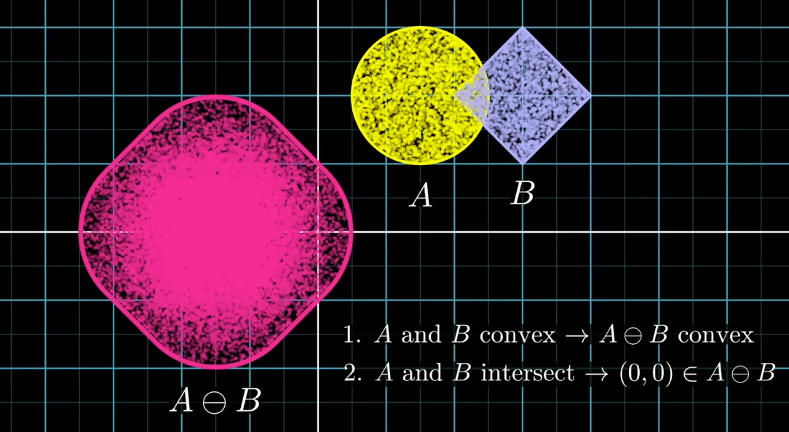
Minkowski-Differenz

Slide 23
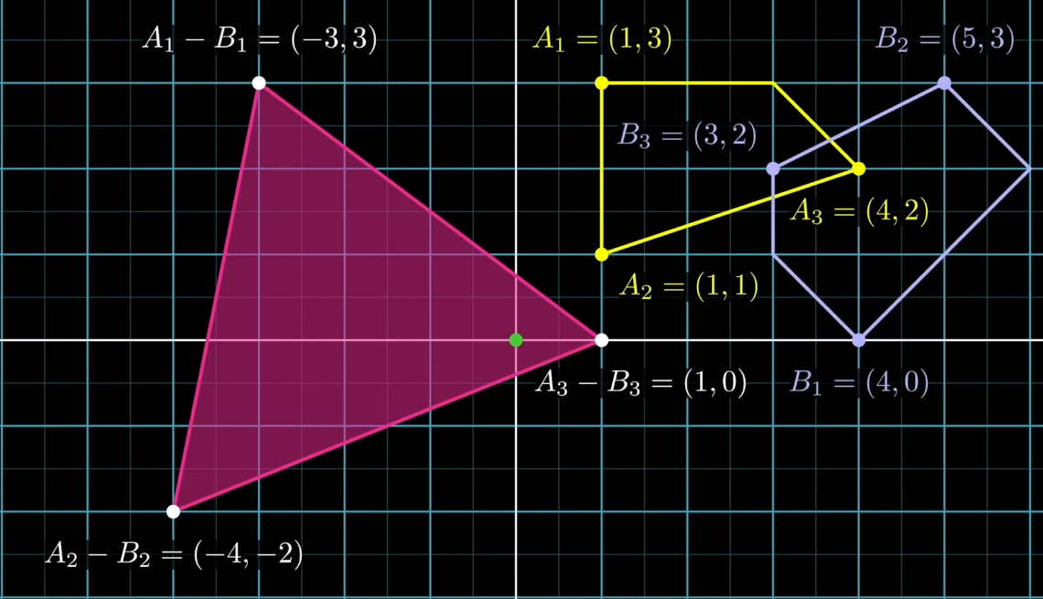
GJK (Gilbert–Johnson–Keerthi)

Slide 24
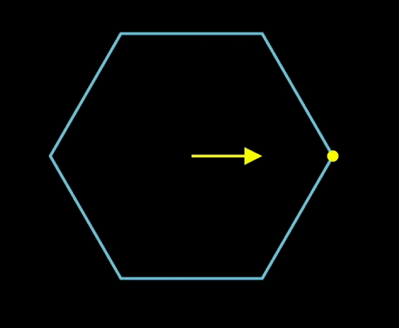
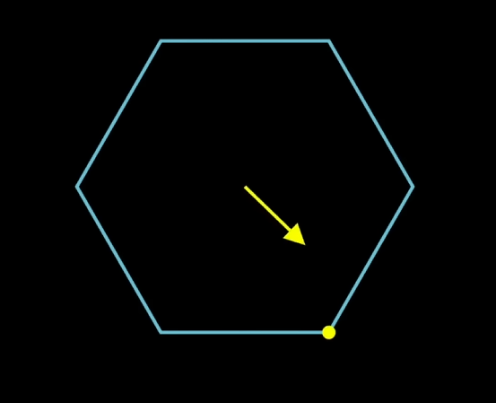
GJK (Gilbert–Johnson–Keerthi)

Slide 25
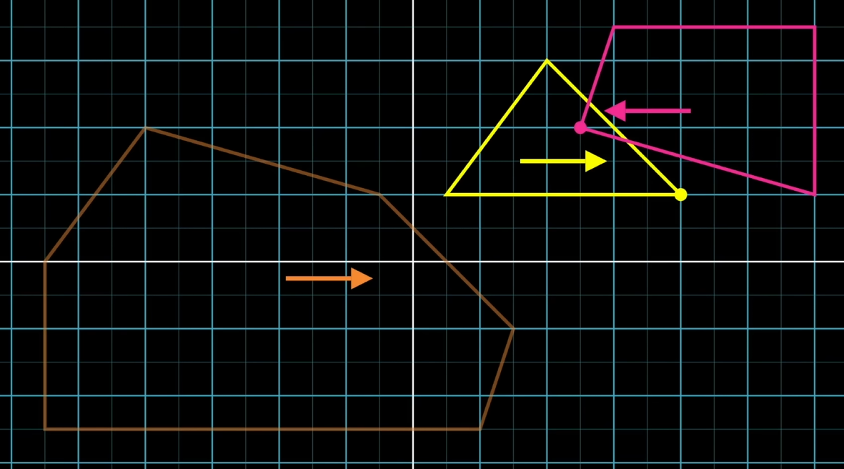
GJK (Gilbert–Johnson–Keerthi)

Slide 26
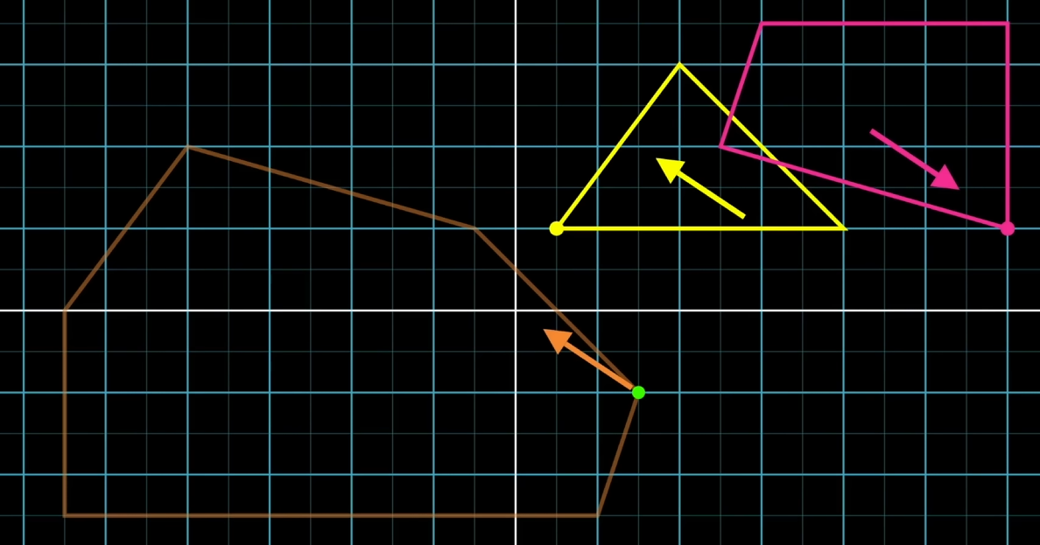
GJK (Gilbert–Johnson–Keerthi)

Slide 27
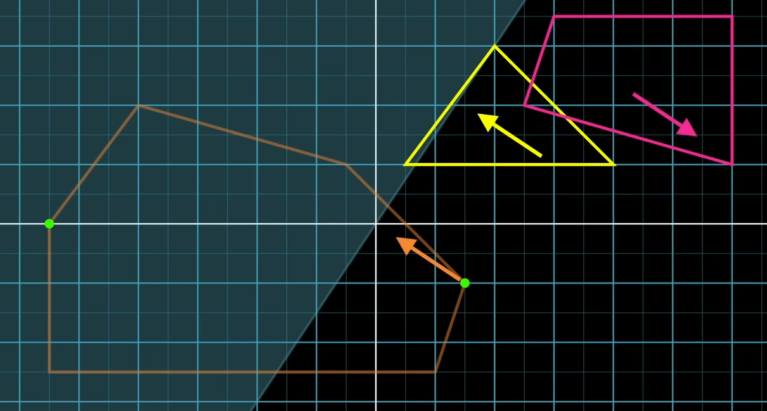
GJK (Gilbert–Johnson–Keerthi)

Slide 28
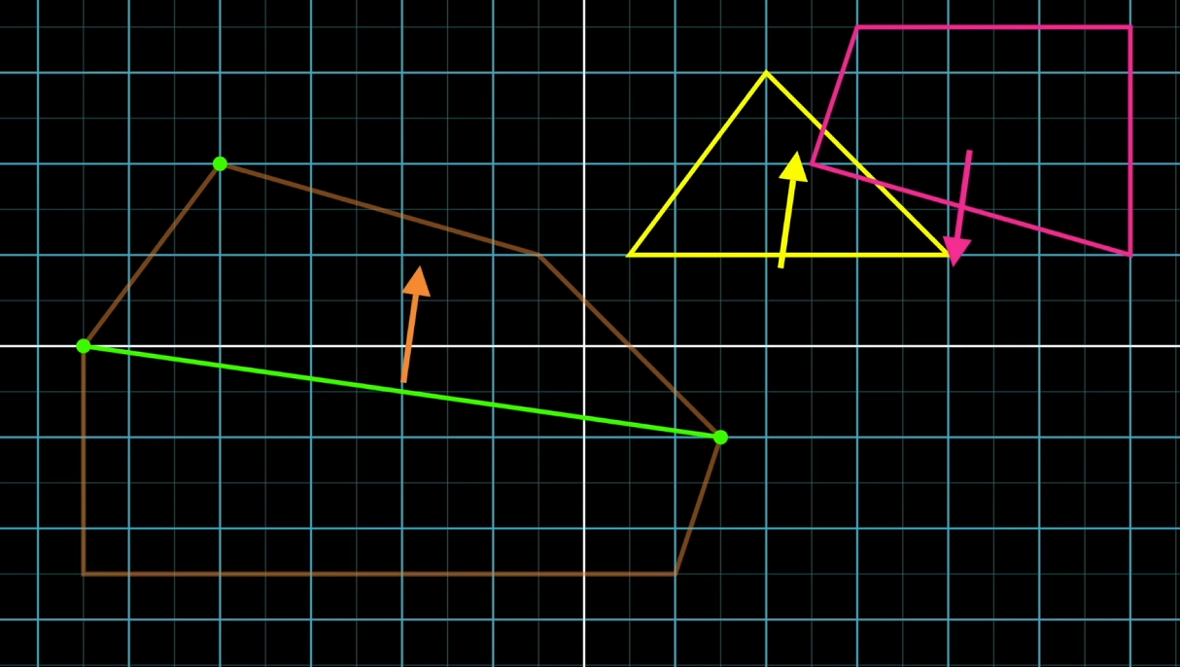
GJK (Gilbert–Johnson–Keerthi)

Slide 29
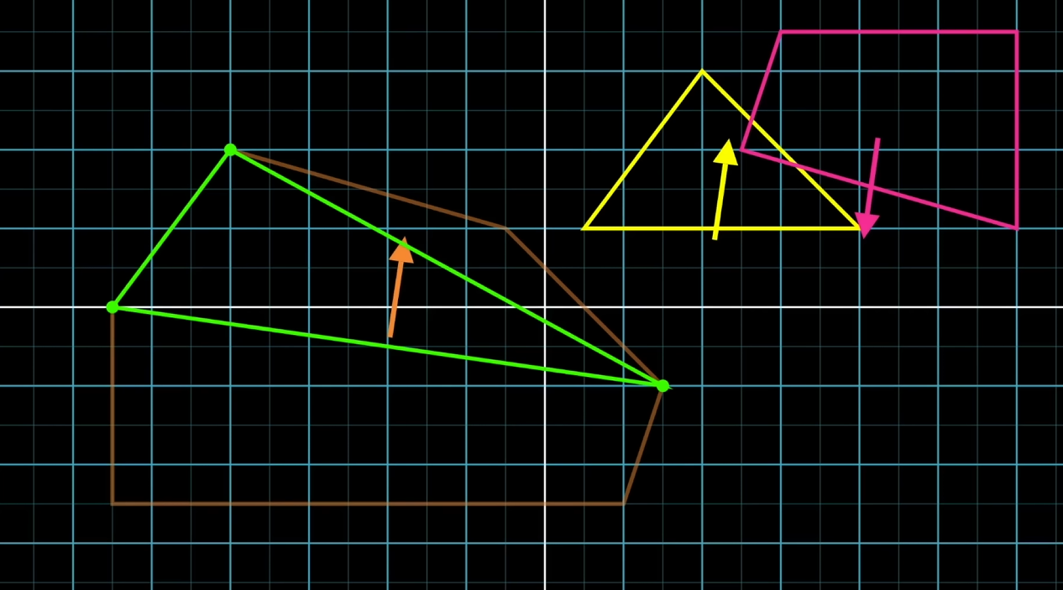
GJK (Gilbert–Johnson–Keerthi)

Slide 30
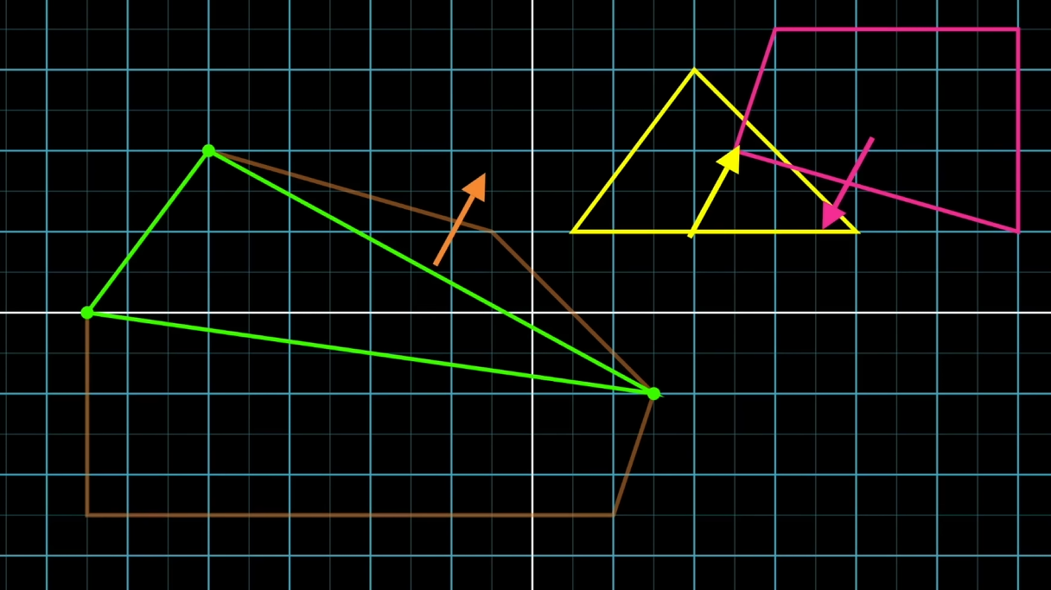
GJK (Gilbert–Johnson–Keerthi)

Slide 31
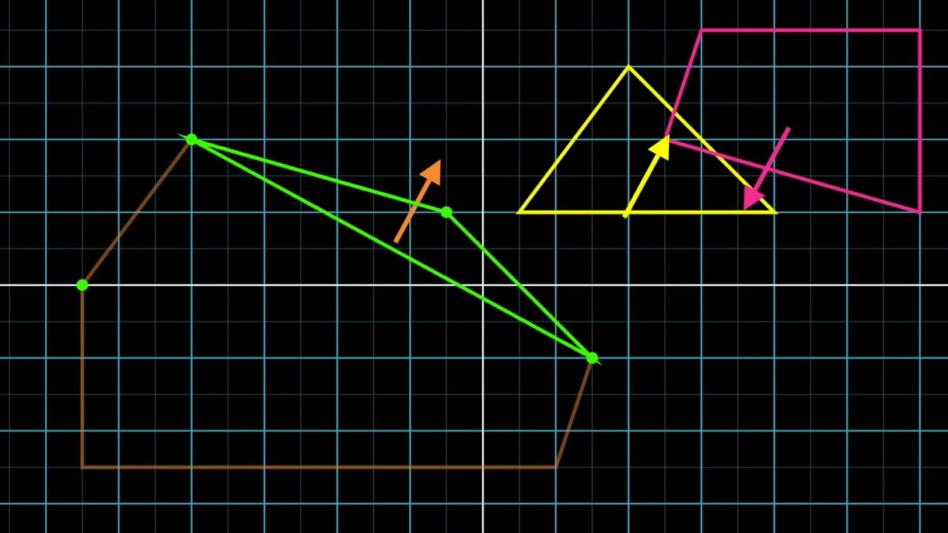
GJK (Gilbert–Johnson–Keerthi)

Slide 32
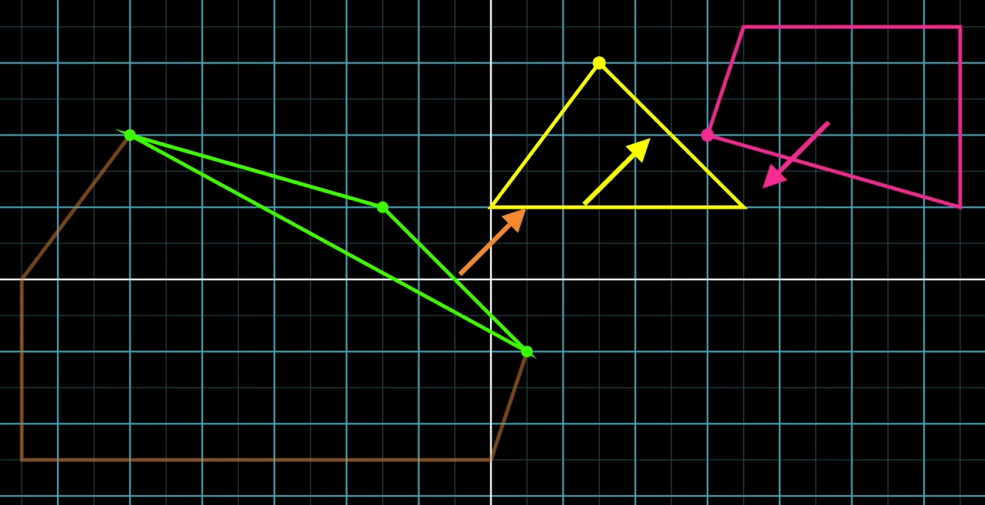
GJK (Gilbert–Johnson–Keerthi)

Slide 33
EPA (Expanding Polytope Algorithm)
Basiert auf GJK
https://dyn4j.org/2010/05/epa-expanding-polytope-algorithm/

Slide 34
Demo
https://winter.dev/articles/gjk-algorithm/app/demo.html
Collision Detection Algorithms, Clemens Kmentt

