Slide 1
Learning 6D object pose for robot manipulation
Yuyang Tu
Universität Hamburg
Fakultät für Mathematik, Informatik und Naturwissenschaften
Fachbereich Informatik
Technische Aspekte Multimodaler Systeme
June 25, 2024

Slide 2
Background
Motivation
Method
Results
Future Work
Related Work
Dexterous Manipulation:
pick and place
tool usage
peg-in-hole assembly
Vision information:
influenced by object occlusion
lighting conditions
intrinsic noise from the camera
Tactile information
2

Slide 3
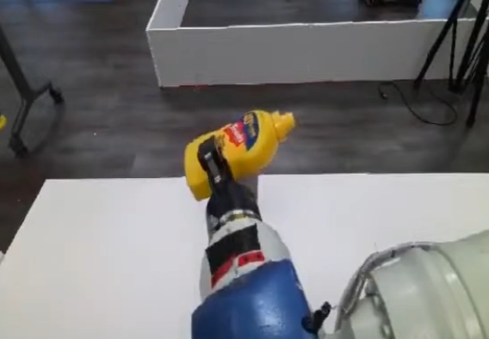
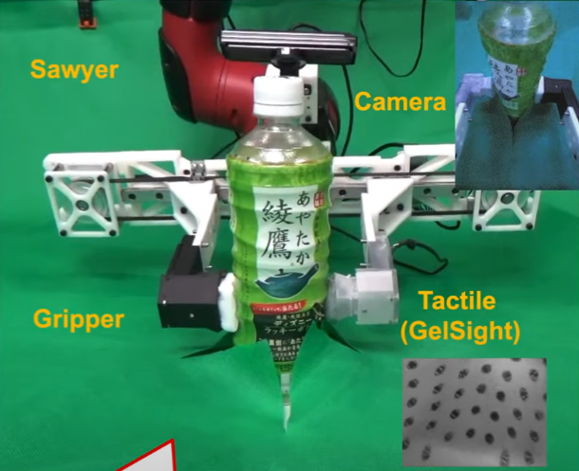
Background
Motivation
Method
Results
Future Work
Related Work
6D ObjectInHand Dataset
Current 6D pose datasets:
two-finger grippers
held in the robot’s hand
fixed on the table
No Relative Movements[1]
Visuo-tactile fusion:
confidence of the different modalities
single modal corruption
Fixed on Table[2]
[1] B. Wen, Et al. “se(3)-TrackNet: Data-driven 6D Pose Tracking by Calibrating Image Residuals in Synthetic Domains,” (IROS), 2020
[2] T. Anzai and K. Takahashi, “Deep gated multi-modal learning: In-hand object pose changes estimation using tactile and image data,” (IROS), 2020
3

Slide 4
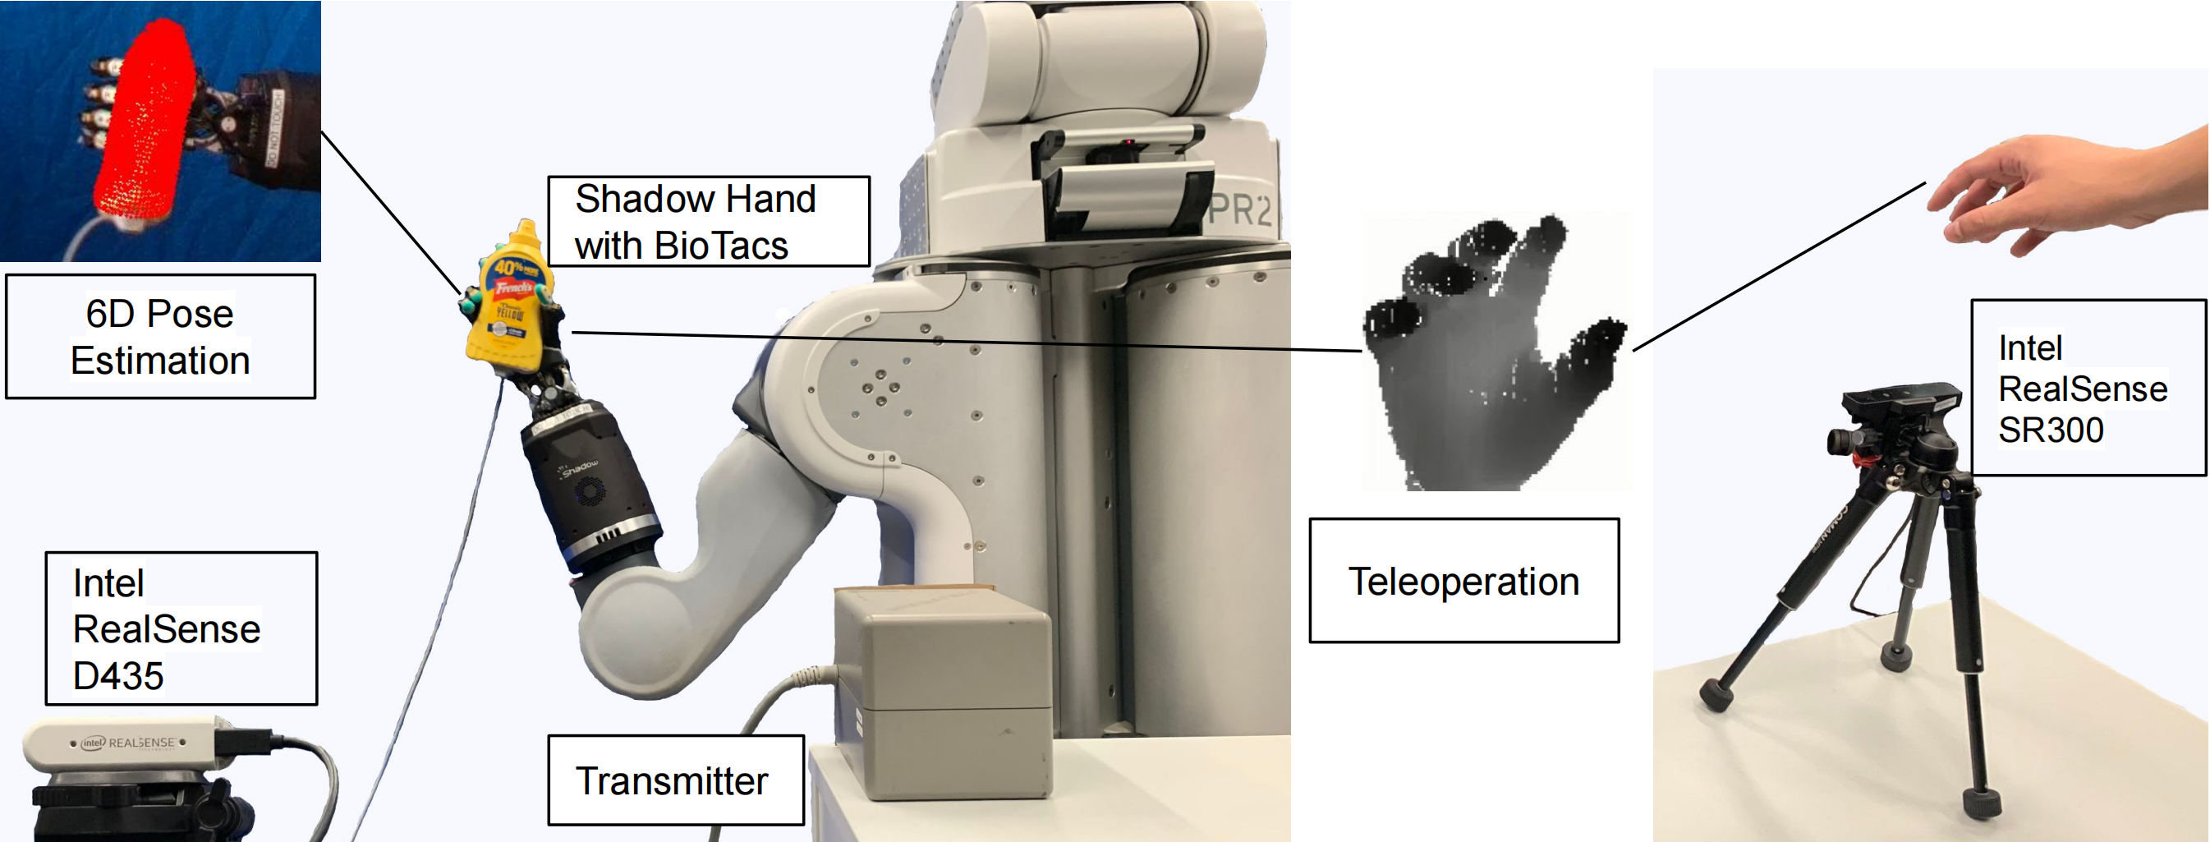
Method
Motivation
Motivation
Method
Results
Future Work
Motivation
4

Slide 5
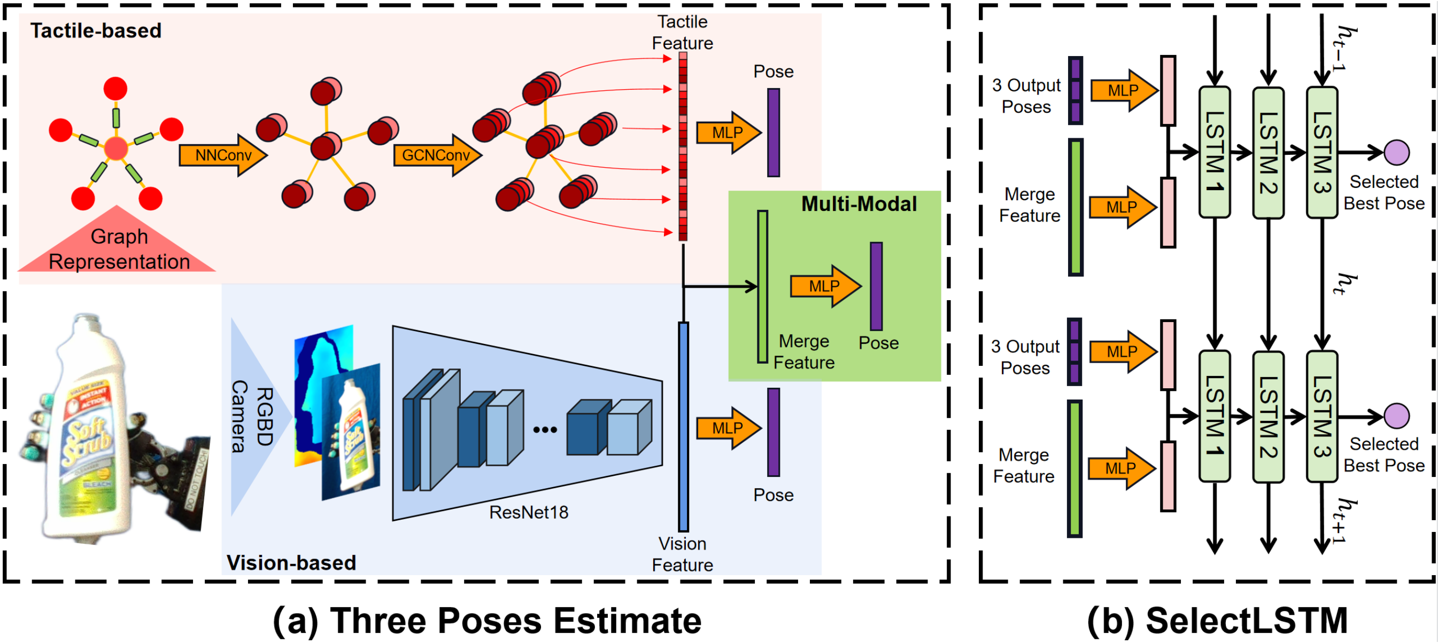
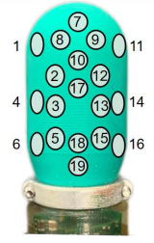
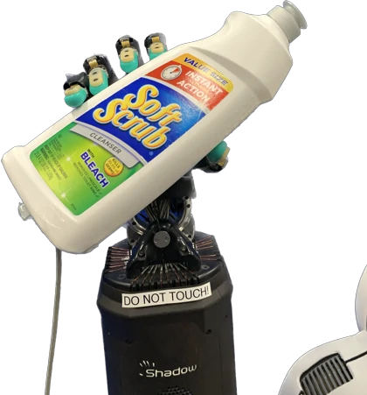
Method
Motivation
Motivation
Method
Results
Future Work
Motivation
5

Slide 6
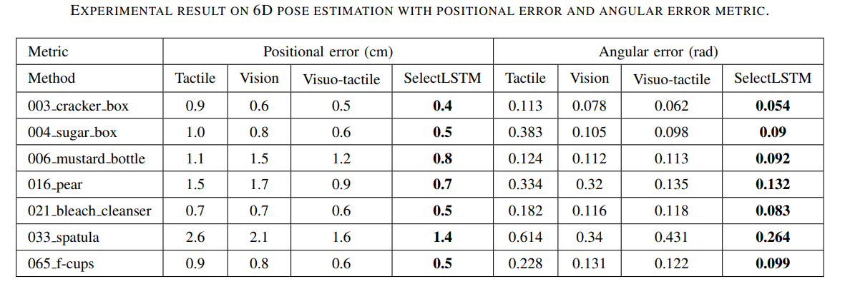
Method
Motivation
Motivation
Method
Results
Future Work
Motivation
6

Slide 7
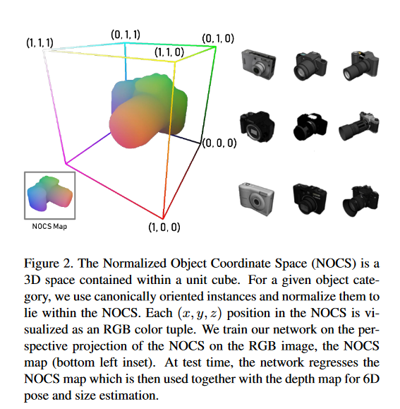
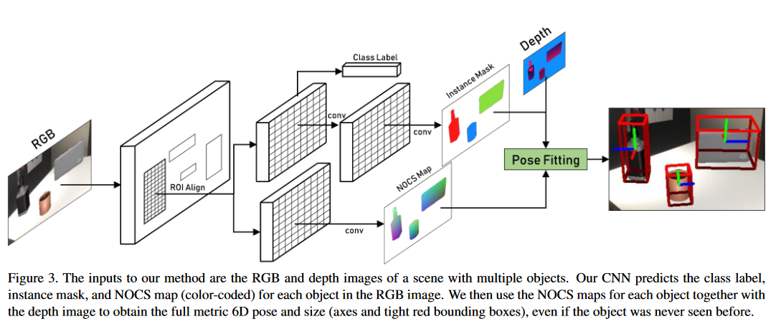
Related Work
Motivation
Method
Results
Future Work
Related Work
Normalized Object Coordinate Space for Category-Level 6D Object Pose and Size Estimation, CVPR, 2019
7

Slide 8
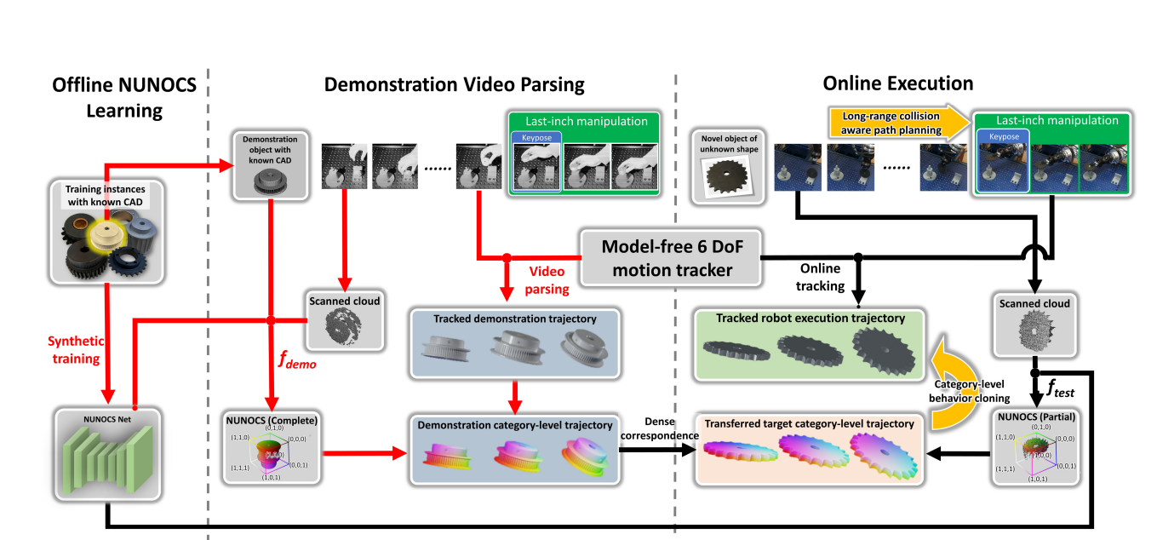
Related Work
Motivation
Method
Results
Future Work
Related Work
You Only Demonstrate Once: Category-Level Manipulation from Single Visual Demonstration, RSS, 2022
8

Slide 9
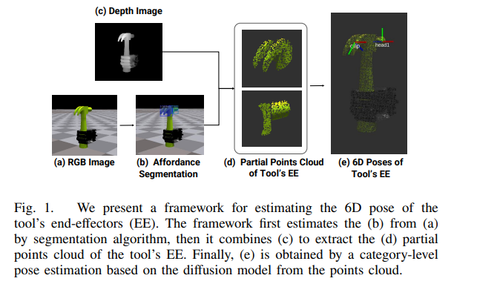
ToolEENet
Motivation
Method
Results
Future Work
Related Work
Canonically defined Object pose
Object EE pose
Submmitted to IROS2024
9

Slide 10
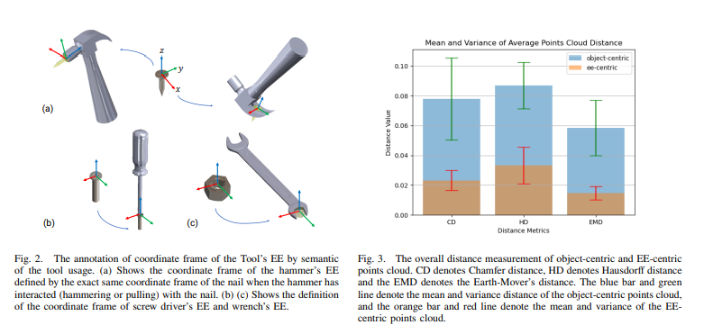
Method
Motivation
Motivation
Method
Results
Future Work
Motivation
10

Slide 11
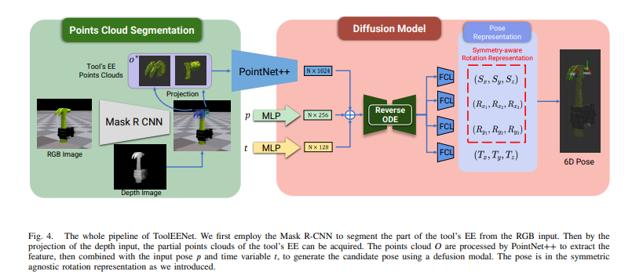
Method
Motivation
Motivation
Method
Results
Future Work
Motivation
11

Slide 12
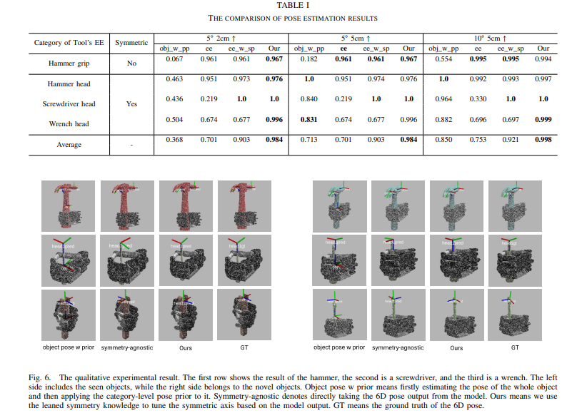
Result
Motivation
Motivation
Method
Results
Future Work
Motivation
12

Slide 13
Result
Motivation
Motivation
Method
Results
Future Work
Motivation
13

Slide 14
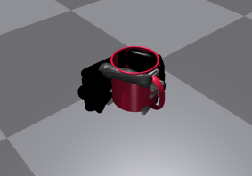
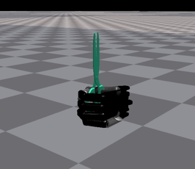
Future Work
Motivation
Method
Results
Motivation
Results
Future Work
Some new object categories
14

Slide 15
Future Work
Motivation
Method
Results
Motivation
Results
Future Work
Some tasks based on new categories
Combine with LLM’s or VLM’s
Prompt engineering
Fine-tuning
15

Slide 16
Motivation
Method
Results
Future Work
Motivation
Thanks for attention!
16

